Slide 1

State Management
Cookies and Sessions
SoftUni Team
Technical Trainers
Software University
https://softuni.bg

Slide 2
Table of Contents
HTTP Cookies
Cookies in a HTTP Server
HTTP Sessions
Sessions in a HTTP Server
3. Session VS Cookies

Slide 3
Have a Question?
sli.do #csharp-web

Slide 4

HTTP Cookies
Usages and Control

Slide 5


What Are Cookies?
A small file of plain text with no executable code
Sent by the server to the client's browser
Stored by the browser on the client's device (computer, tablet, etc.)
Hold small piece of data for a particular client and a web site

Slide 6

What Are Cookies Used for?
Session management
Logins, shopping carts, game scores, or anything else the server should remember
Personalization
User preferences, themes, and other custom settings
Tracking
Recording and analyzing user behavior

Slide 7


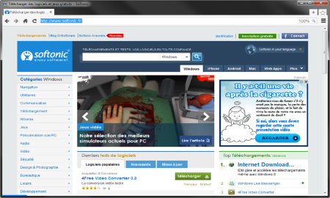



Session Management
The HTTP object is stateless
It doesn’t store information about the requests
Web Client
Web Application
GET
POST
GET
Not stored

Slide 8
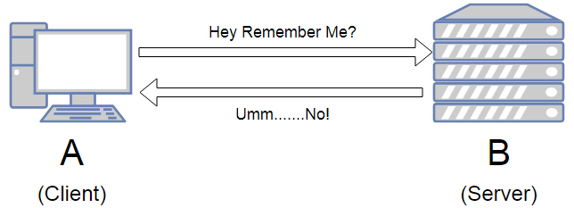
Stateless HTTP – the Problem
The server doesn't know if two requests come from the same client
State management problems
Navigation through pages requires authentication each time
Information about the pages is lost between the requests
Harder personalization of functionality of pages

Slide 9
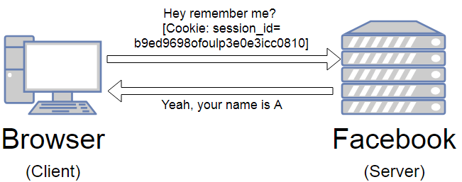
Stateless HTTP – the Cookie Solution
A reliable mechanism for websites to remember stateful information
To know whether the user is logged in or not
To know which account the user is logged in with
To record the user's browsing activity
To remember pieces of information previously entered into form fields (usernames, passwords, etc.)

Slide 10
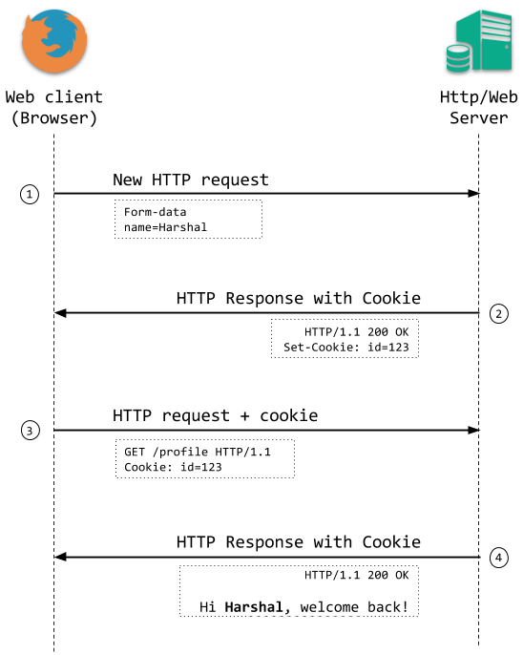
How Are Cookies Used?
The response holds the cookies to be saved within the Set-Cookie header
The request holds the specific web site cookie within the Cookie header
HTTP/1.1 200 OK
Set-Cookie: lang=en
GET www.example.bg HTTP/1.1
Cookie: lang=en

Slide 11

Server-Client Cookies Exchange
http://www.example.bg/
Web Client
Web Application
GET www.example.bg HTTP/1.1
HTTP/1.1 200 OK Set-Cookie: lang=en
GET www.example.bg HTTP/1.1
Cookie: lang=en

Slide 12
Cookie Structure
The cookie consists of Name, Value and Attributes (optional)
The attributes are key-value pairs with additional information
Attributes are not included in the requests
Attributes are used by the client to control the cookies
Name=Value
Attributes
Set-Cookie: SSID=Ap4P…GTEq; Domain=foo.com; Path=/; Expires=Wed, 13 Jan 2021 22:23:01 GMT; Secure; HttpOnly

Slide 13
Scope
Defined by the attributes Domain and Path
Domain – defines the website that the cookie belongs to
Path – Indicates a URL path that must exist in the requested resource before sending the Cookie header
Set-Cookie: SSID=Ap4P…GTEq; Domain=foo.com; Path=/; Expires=Wed, 13 Jan 2021 22:23:01 GMT; Secure; HttpOnly

Slide 14
Lifetime
Defined by the attributes Expires and Max-Age
Expires – defines the date the browser should delete the cookie
By default the cookies are deleted after the end of the session
Max-Age – interval of seconds before the cookie is deleted
Set-Cookie: SSID=Ap4P…GTEq; Domain=foo.com; Path=/; Expires=Wed, 13 Jan 2021 22:23:01 GMT; Secure; HttpOnly

Slide 15
Security
Security flags do not have associated values
Secure - tells the browser to use cookies only via secure/encrypted connections
HttpOnly – defines that the cookie cannot be accessed via client-side scripting languages
Set-Cookie: SSID=Ap4P…GTEq; Domain=foo.com; Path=/; Expires=Wed, 13 Jan 2021 22:23:01 GMT; Secure; HttpOnly

Slide 16
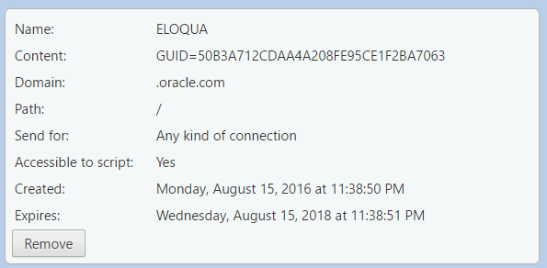
What is in the Cookie?
The cookie file contains a table with key-value pairs

Slide 17
Examine Your Cookies (1)
Most cookies are stored in a RDBMS, usually SQLite
Download SQLite browser from here
Location of Mozilla cookies
Location of Chrome cookies
C:\Users\{username}\AppData\Roaming\Mozilla\Firefox\Profiles\{name}.default\cookies.sqlite
C:\Users\{username}\AppData\Local\Google\Chrome\User Data\Default\Cookies

Slide 18
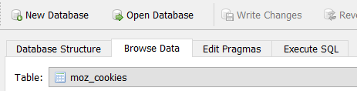
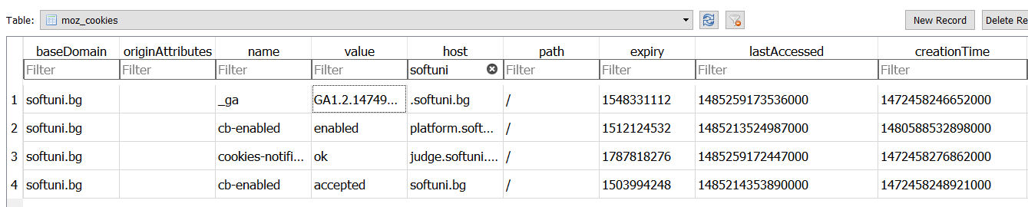
Examine Your Cookies (2)
Open the file with the SQLite browser
Browse the cookies table
Name
Host
Expiration date
Created on
Value
Paths
Last accessed on

Slide 19
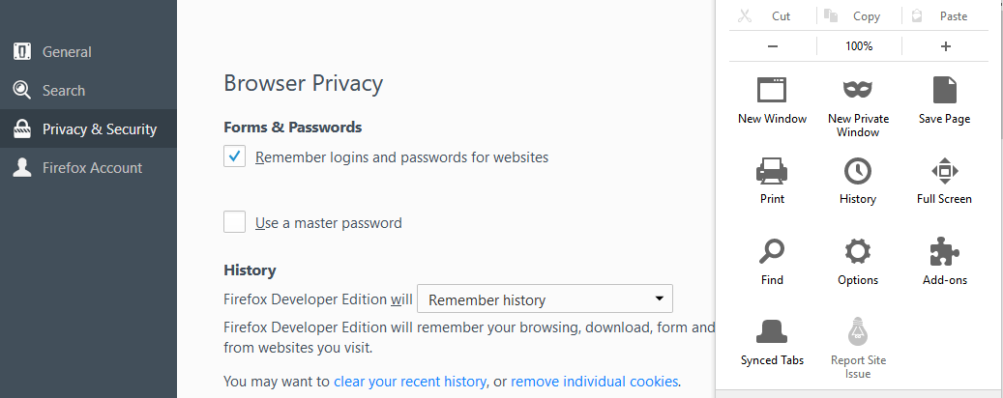
Control Your Cookies – Mozilla Browser (1)

Slide 20
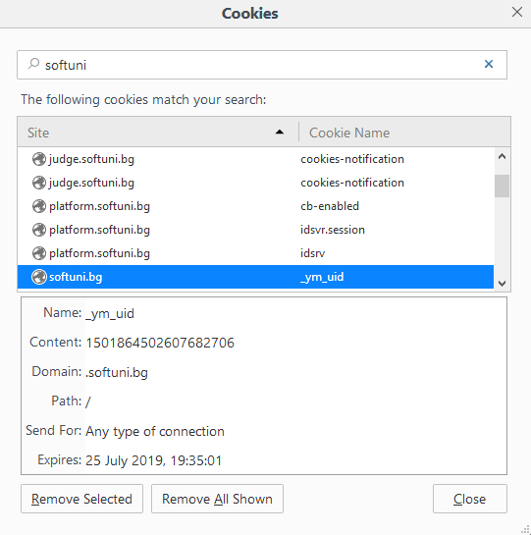
Control Your Cookies – Mozilla Browser (2)
Browse cookies from a selected website
Delete a particular cookie or all cookies

Slide 21
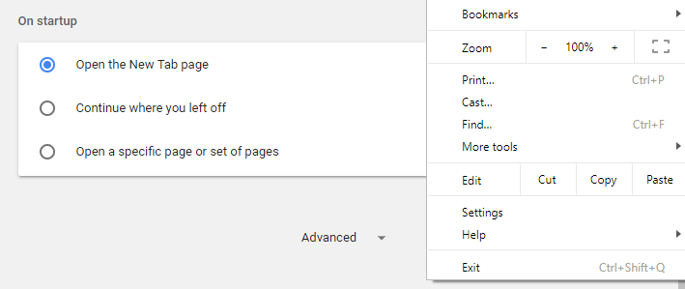


Control Your Cookies – Chrome Browser

Slide 22
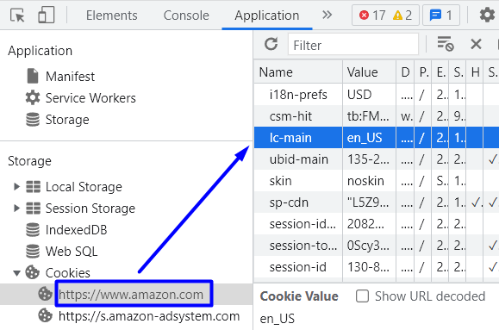
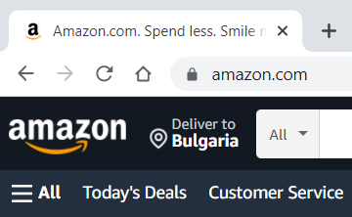
Change Cookie – Demo
Go to the Amazon site and look at the menu language
Open DevTools → [Application] and search for the language cookie

Slide 23
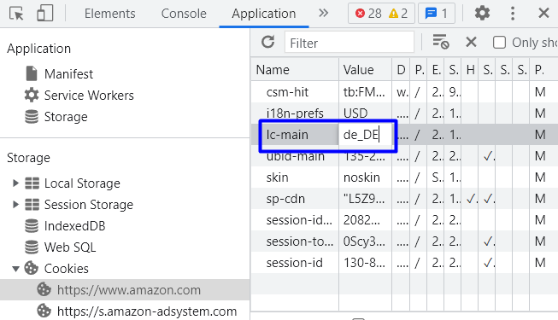
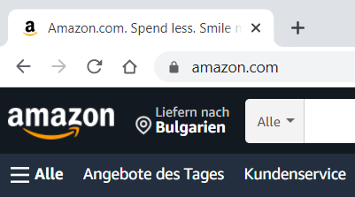
Change Cookie – Demo
Change the cookie value to "de_DE" to change the language of the app
Refresh the site → it should be in German now

Slide 24
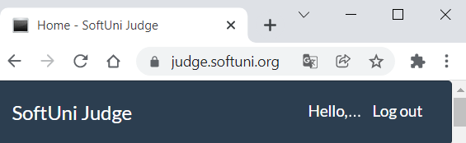
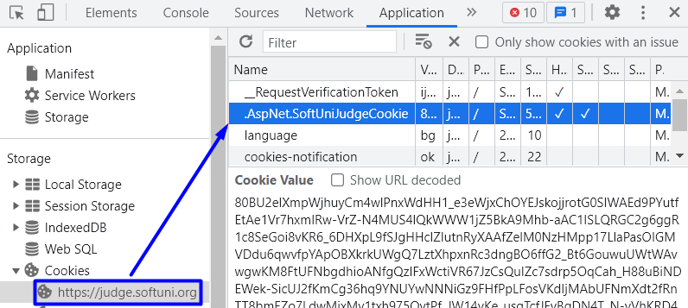
Authentication with Cookies – Demo
Go to the SoftUni Judge site and log in
Search for the authentication cookie in the Cookies menu

Slide 25
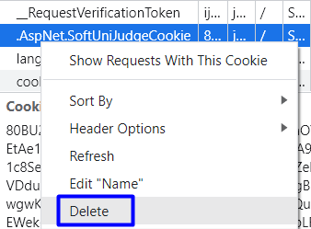
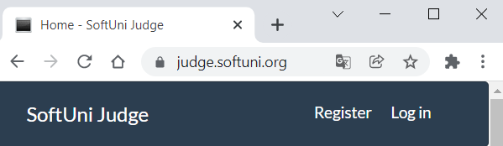
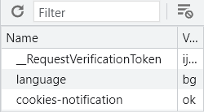
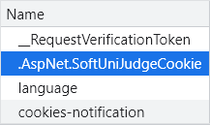
Authentication with Cookies – Demo
Delete the authentication cookie
Refresh the SoftUni's site → you are not logged-in anymore
An authentication cookie is now missing
Log in the site again → a new cookie should appear

Slide 26


Third Party Cookies
Cookies stored by an external party (different domain)
http://stackoverflow.com/
Web Application
Web Client
Cookie transfer
Cookie transfer
Third Party

Slide 27
Third Party Cookies
Cookies stored by an external party (different domain)
Mainly used for advertising and tracking across the web
http://stackoverflow.com/
Web Client
Web Application
Cookie transfer
Cookie transfer
Third Party

Slide 28

HTTP Sessions

Slide 29

What Are Sessions?
A way to store information about a user to be used across multiple pages
/login
Web Application
Session
/home
user: Teo
/products

Slide 30
Session Management
The exchange mechanism be used between the user and the web application
First Time Login
Web Client
Web Application
User credentials
Session ID

Slide 31
Session Management
The exchange mechanism be used between the user and the web application
Browsing Pages
Web Client
Web Application
Session ID
Requested data + Session ID

Slide 32
Session Management
The exchange mechanism be used between the user and the web application
Browsing pages after
the server is restarted
Web Client
Web Application
Session ID
Requested Data + Session ID

Slide 33
Relation with Cookies
Session Store
sid 5 { uid: 101 }
sid 7 { uid: 102 }
Cookie {
name: sid value: 5
}
Validate
Req
Web Application
Session
Resp
Database
Cookie {
name: sid value: 7
}
Req
Get data
uid name 101 Teo
102 Bojo
Resp
Create personal web page

Slide 34
Session Structure
"hje85d3" : {
user_id: 789
username: FirstUser
},
"af354dd" : {
user_id: 456
username: SecondUser
},
"fg78e5s" : {
user_id: 654
username: ThirdUser
}
Unique
Session ID
Key-Value pairs with user data

Slide 35
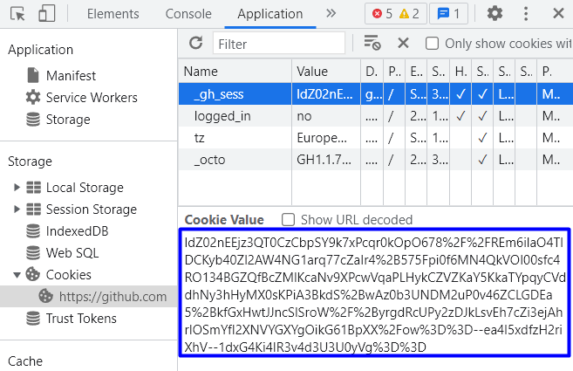
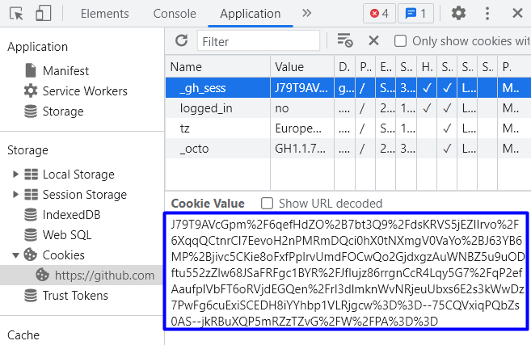
Session – Demo
Go to the GitHub site
Examine the session cookie, which holds the current session id
Close the browser and visit the site again
Notice that now there is a new session with a different ID

Slide 36
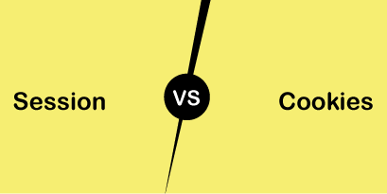
Session VS Cookies
Differences and Usage

Slide 37
Session VS Cookies
Session | Cookies
Stored on the server | Stored on the user's computer as a text file
Expires when the user closes the browser | Expires on its expiration date
It can store an unlimited amount of data | It can store only limited data
Depends on the cookie | Does not depend on the session
Secure, as it saves data in encrypted form and cannot be accessed by anyone easily | Have security issues, as data is stored in a text file and it can be accessed by anyone easily

Slide 38

Summary
Cookies are client based stored information
They are created by web applications
Browser sends them back to the application
Sessions are server based information
They are used across multiple pages
Stores important info about the client
…
…
…

Slide 39
Questions?
Notes:
39

Slide 40













SoftUni Diamond Partners

Slide 41


Educational Partners

Slide 42
Trainings @ Software University (SoftUni)
Software University – High-Quality Education, Profession and Job for Software Developers
softuni.bg, about.softuni.bg
Software University Foundation
softuni.foundation
Software University @ Facebook
facebook.com/SoftwareUniversity
Software University Forums
forum.softuni.bg
42
Notes:
42

Slide 43

License
This course (slides, examples, demos, exercises, homework, documents, videos and other assets) is copyrighted content
Unauthorized copy, reproduction or use is illegal
© SoftUni – https://about.softuni.bg
© Software University – https://softuni.bg
Notes:
43

